Slide 1

Exploration of the factors driving use of BiciMAD.
Elizabeth Sames

Slide 2
Air pollution
4.2 million deaths yearly
9 out of every 10 people breathe polluted air
Notes:
Causes 4.2 million deaths worldwide annually.
Over 90% of the global population live where air pollution levels exceed World Health Organization guidelines.

Slide 3
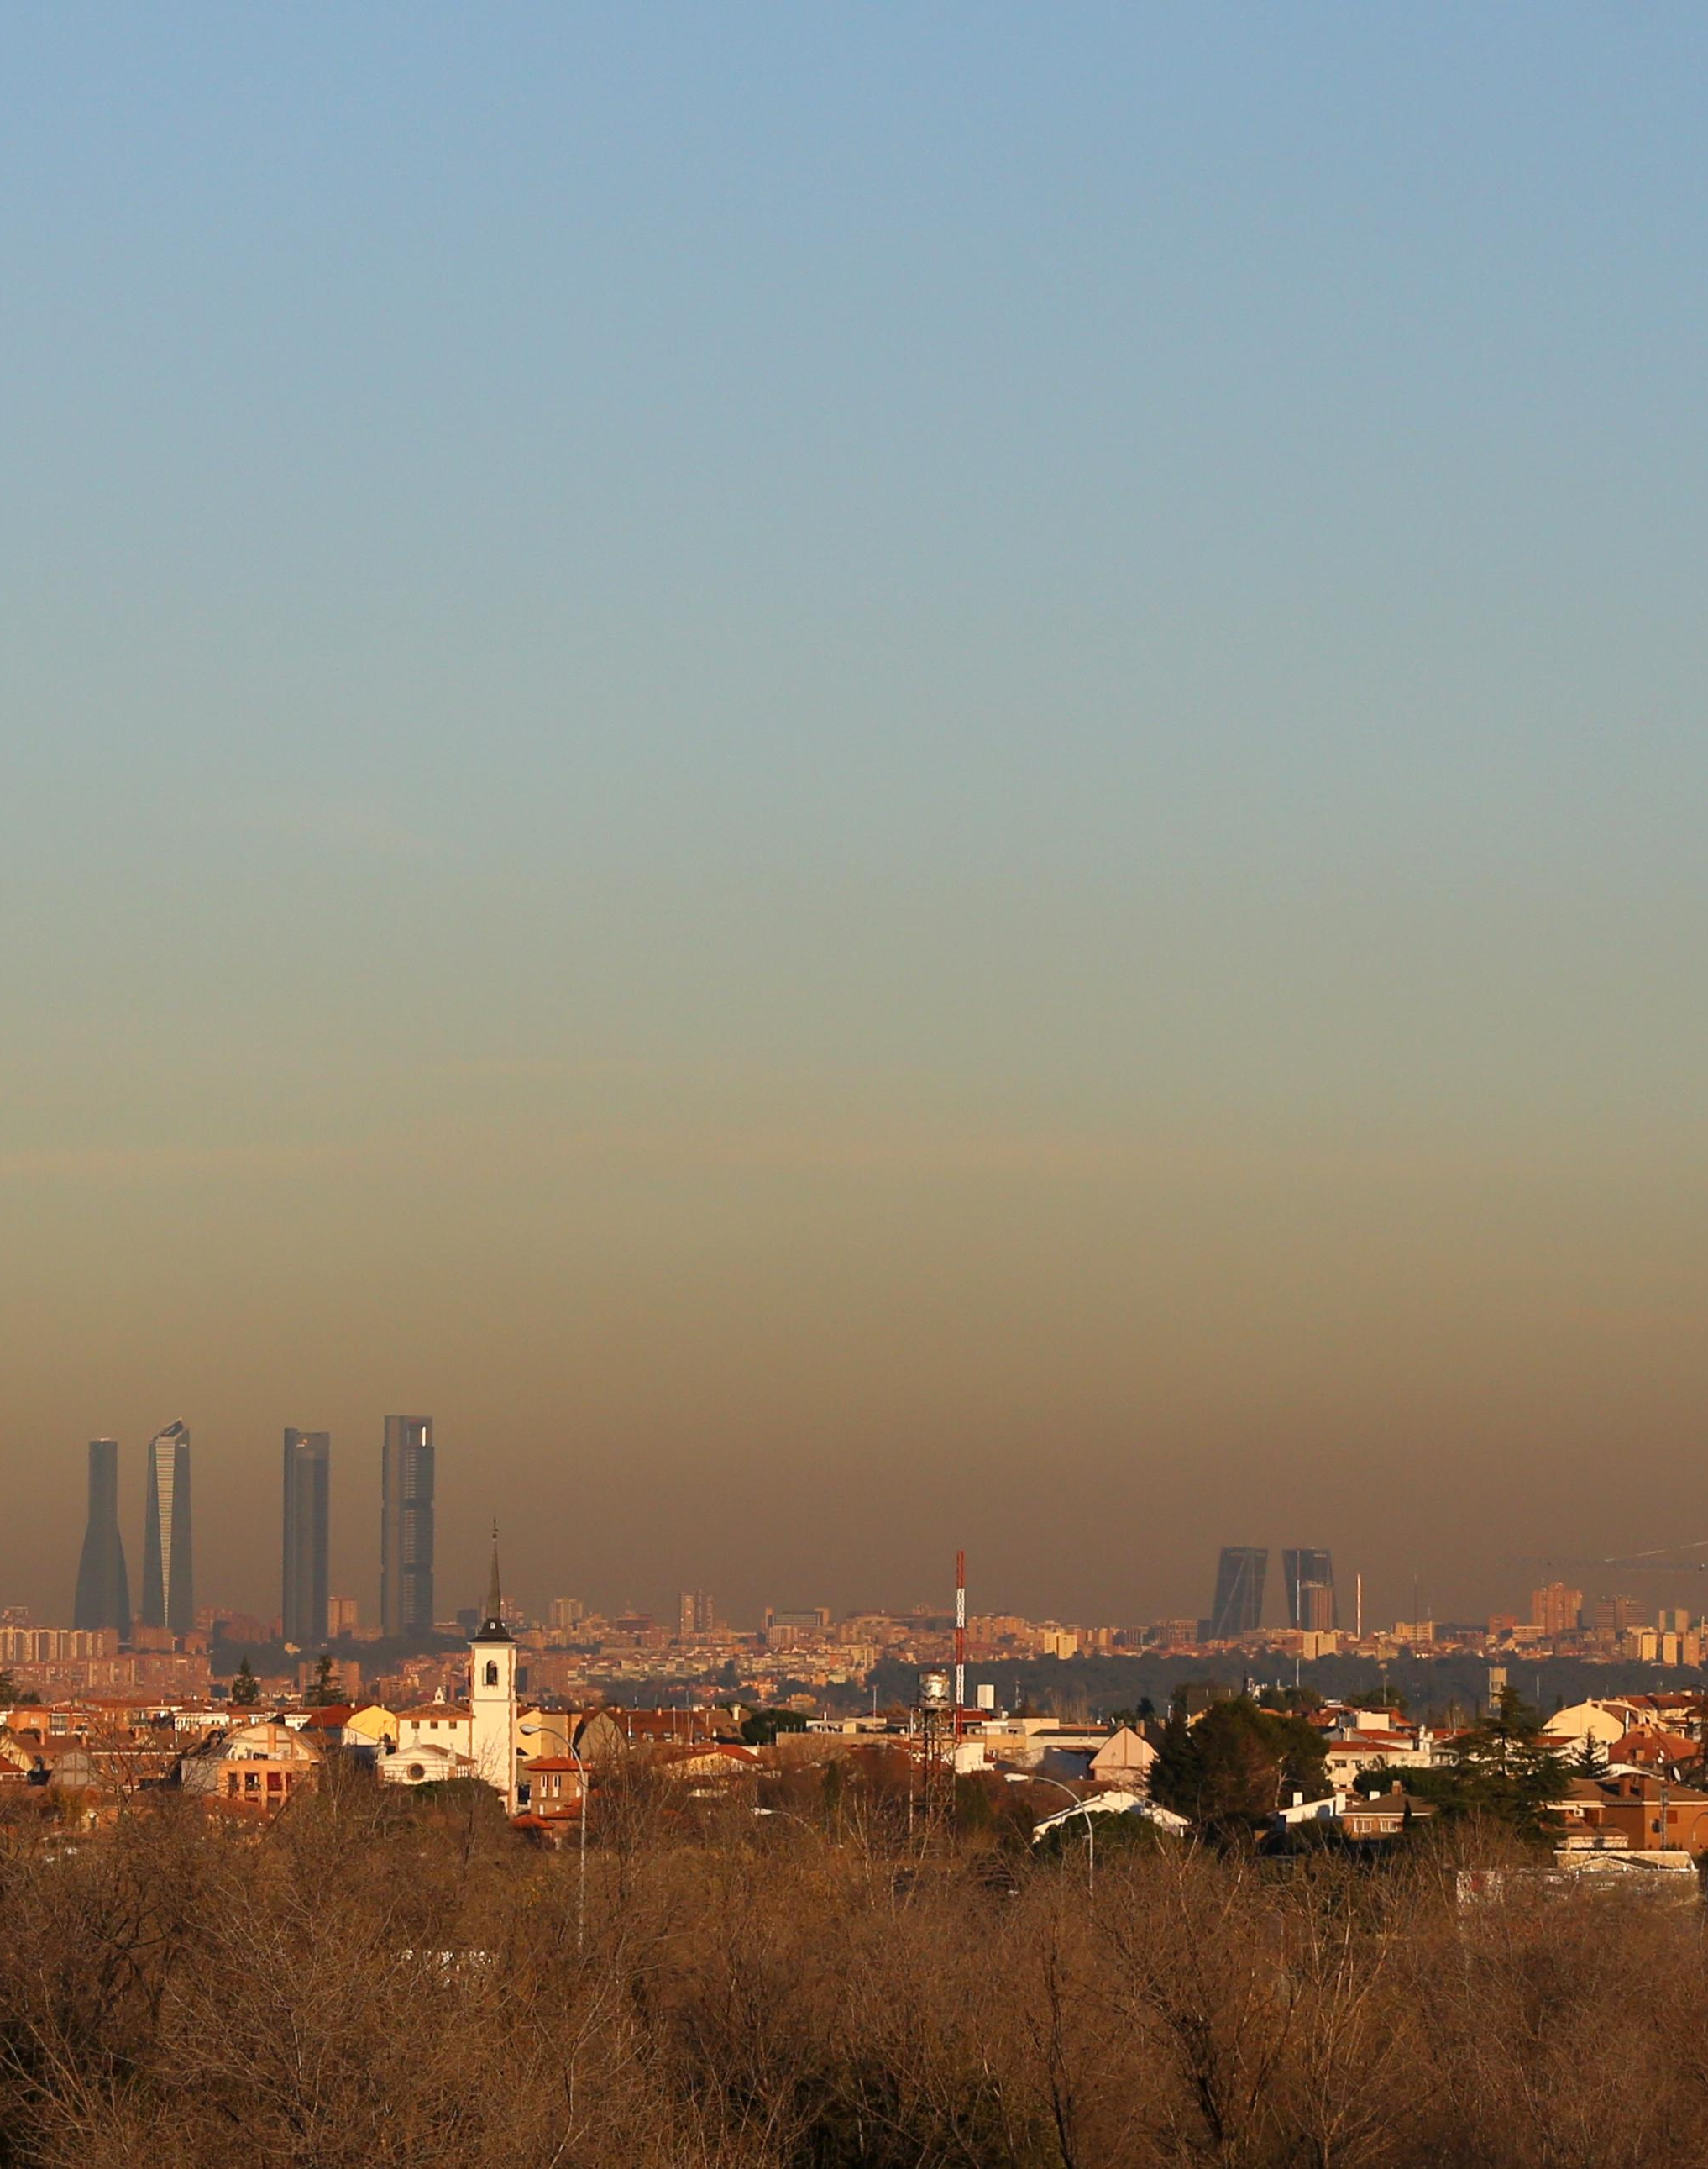
Air pollution in Madrid
Madrid has the highest premature mortality linked to nitrogen-dioxide pollution within Europe.
In urban areas, the main contributor to NO2 pollution is traffic.
Urban NO2 concentrations could be reduced up to 40% through the implementation of traffic policies.

Slide 4
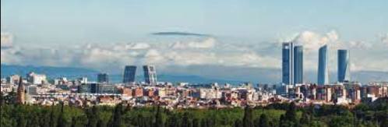
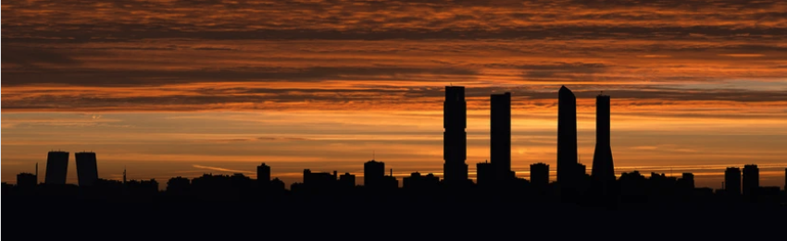
We can change this!
March-June 2020 COVID-19 lockdown
NO2 concentrations in Madrid decreased by 62%!!!

Slide 5
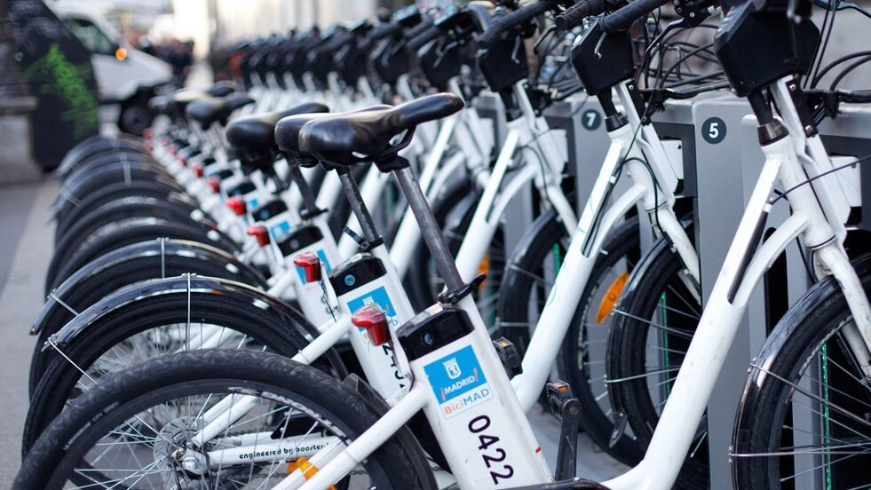
BiciMAD
Over 2000 electric bicycles
Over 260 docking stations
Stations every 300 meters
Dataset source: open data from EMT Madrid for July 2020-June2021

Slide 6
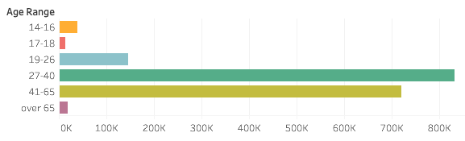
Who are the users?

Slide 7
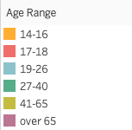
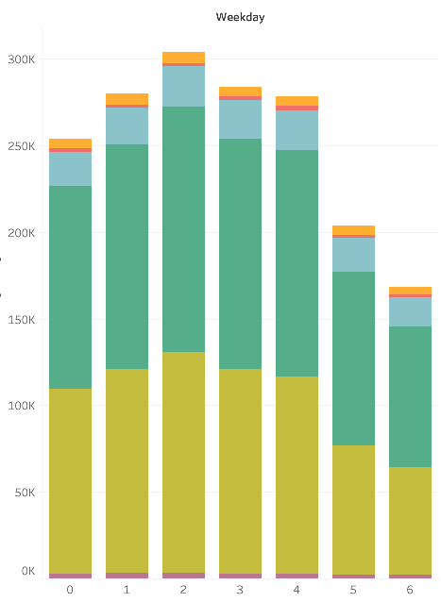
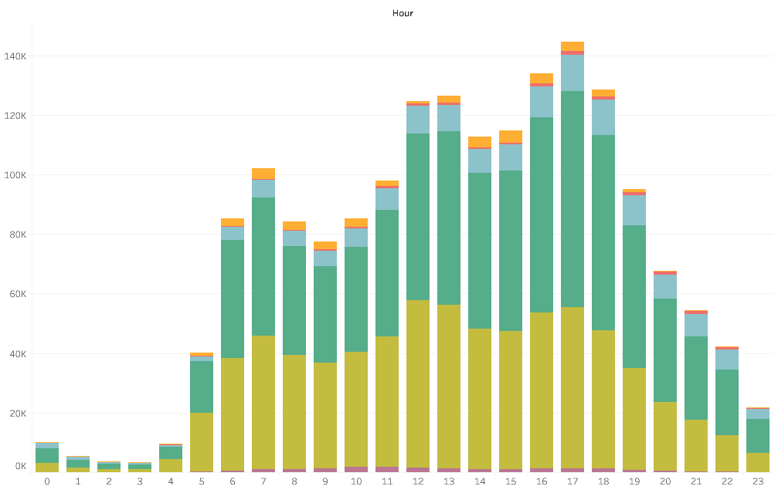
User age as a factor
Age and weekday are not independent variables.
Age and hour are not independent variables.

Slide 8
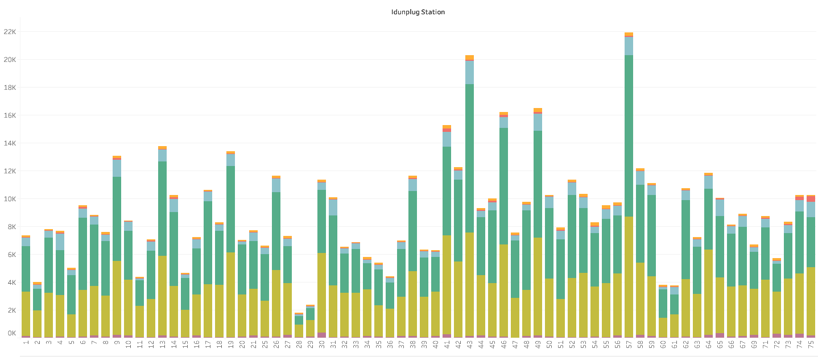
Age and station are not independent variables.

Slide 9
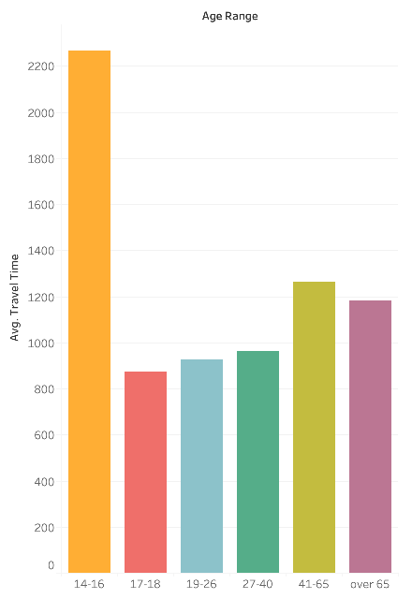
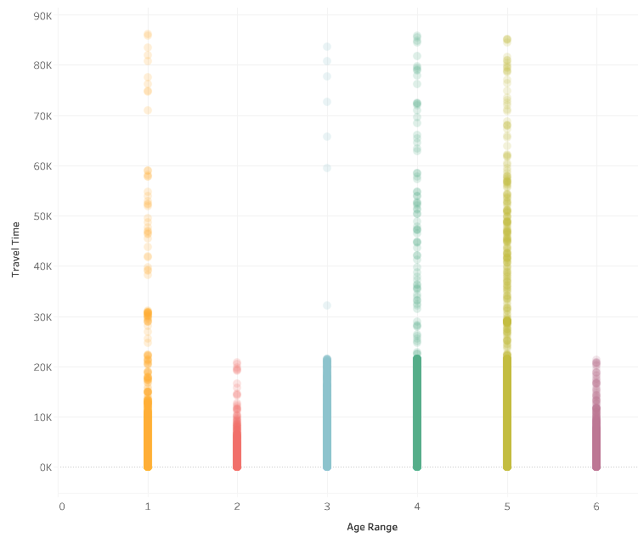
Factors that affect travel time
Age and travel time

Slide 10
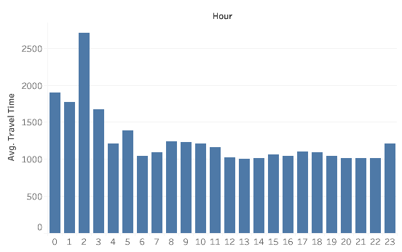
Factors that affect travel time
hour vs mean travel time

Slide 11
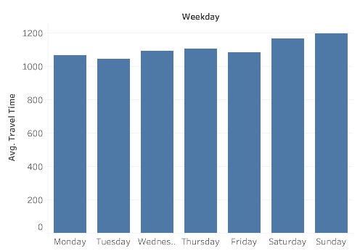
weekday vs mean travel time

Slide 12

Is weather a factor in usage of BiciMAD?

Slide 13
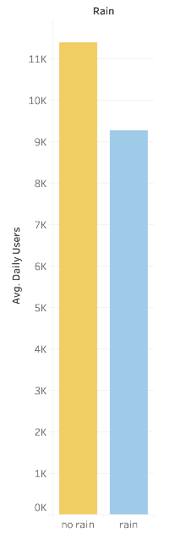
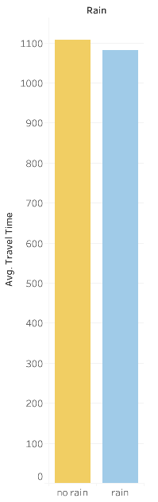
Rain as a factor:
Negative correlation between rain and mean daily users.
Rain does not seem to have a strong affect on travel time.

Slide 14
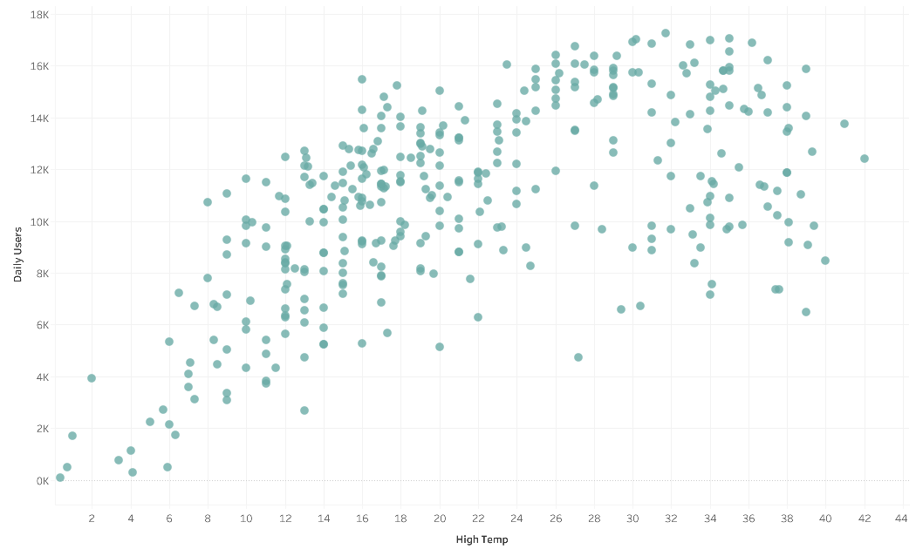
Temperature as a factor:
Positive correlation between high temp and number of users.

Slide 15
Building the regression models

Slide 16
Predict number of users
Daily vs hourly level
Entire BiciMAD system vs station specific

Slide 17
Results:
Weekday + forecast => total daily users: r2-score= .57 rmse=2437
Weekday + forecast + hour => hourly users r2-score=.69 rmse=190
Weekday + forecast + hour + station => hourly users by station r2-score=.21 rmse=2

Slide 18
What do the results mean?
Day of the week, time of day, temperature, and precipitation are all factors driving use of the BiciMAD bikesharing service.
Other factors involved.

Slide 19
Further exploration requiring additional data
Socioeconomics differences between areas
Connection to other types of transport
"Bikeability" of different areas

Slide 20
Sources:
BiciMAD data: Madrid EMT https://opendata.emtmadrid.es/Datos-estaticos/Datos-generales-(1)
Weather data: Tutiempo https://en.tutiempo.net/climate/07-2020/ws-82210.html
Air pollution facts:
World Health Organization https://www.who.int/health-topics/air-pollution#tab=tab_1
The Lancet https://www.thelancet.com/journals/lanplh/article/PIIS2542-5196(20)30272-2/fulltext
European Commission Urban NO2 Atlas https://publications.jrc.ec.europa.eu/repository/handle/JRC118193
Science Direct https://www.sciencedirect.com/science/article/pii/S0048969720338754

